Slide 1
Practice 1 - with CPUScheduler Simulator V1

Slide 2
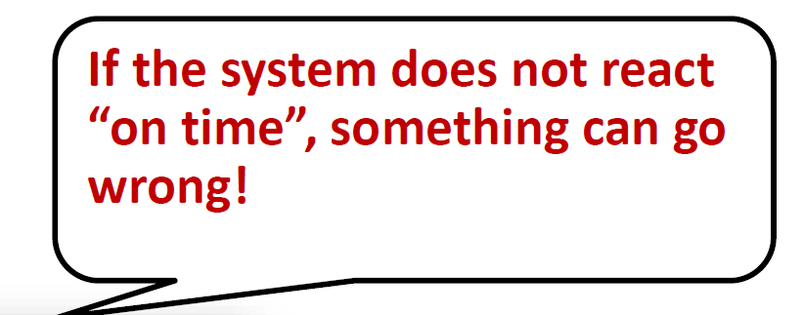

Background : What is a real-time system?
Real-Time system
A system whose correctness depends not only on the correctness of logical results (e.g., decisions), but also on the time at which the results are produced

Slide 3
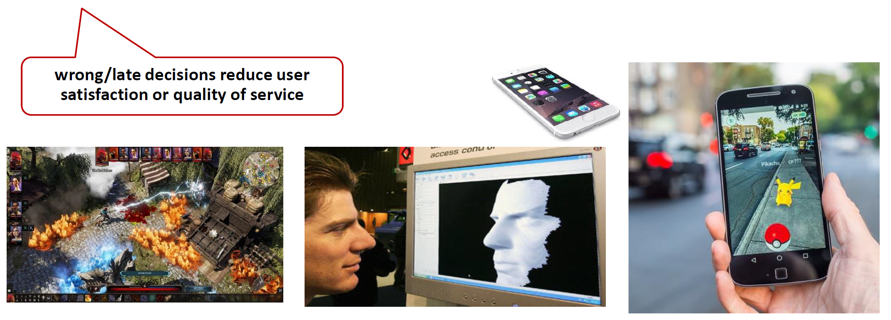
Classes of real-time systems
Soft real-time
Systems where deadlines are important but which will still function correctly if deadlines are occasionally missed

Slide 4
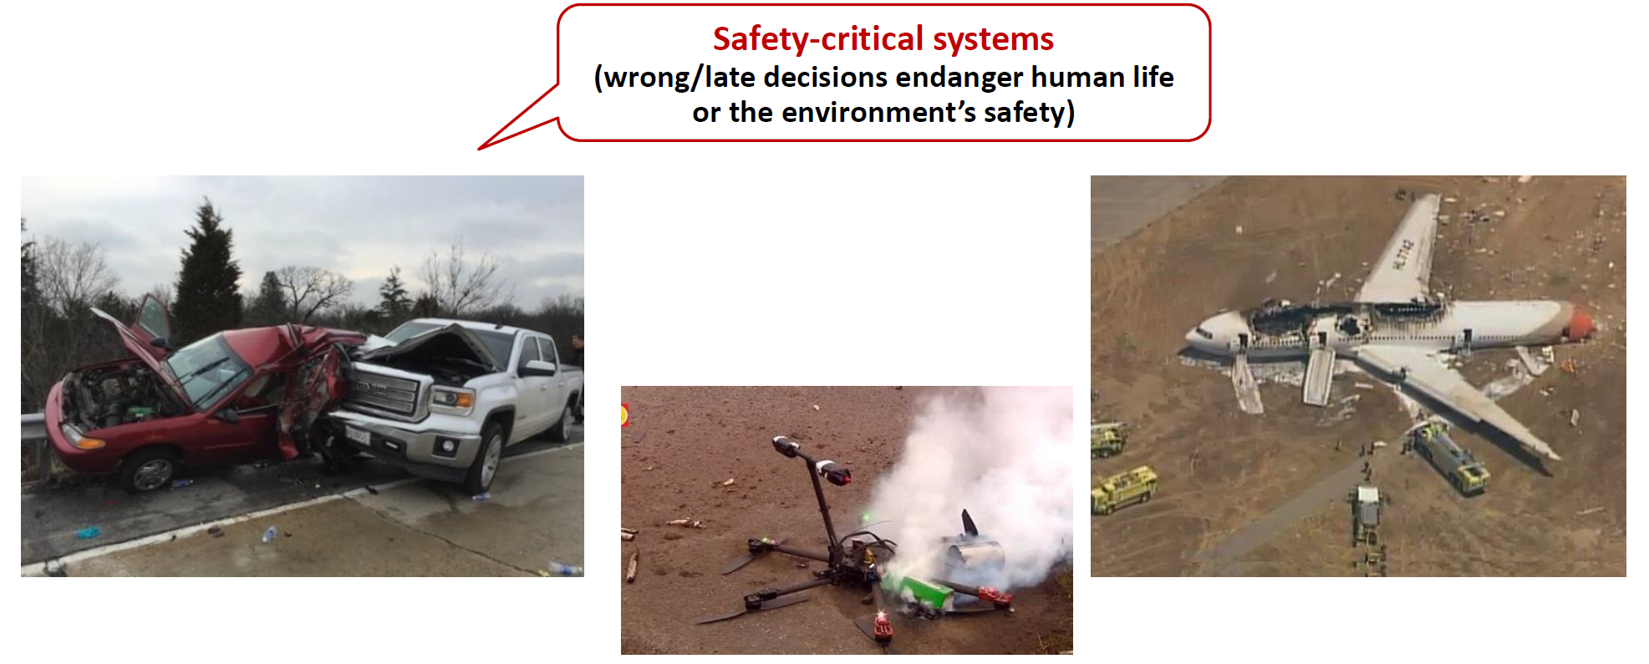
Classes of real-time systems
Hard real-time
Systems where it is absolutely imperative that responses occur within the required deadline

Slide 5

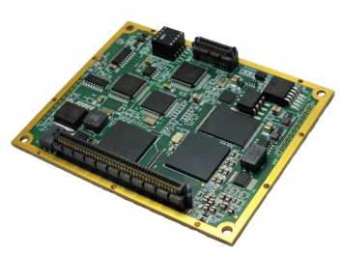
Real-time scheduling
Definition
A policy to assign computing resources to execute tasks according to scheduling algorithm such that all constraints are met
brake
wiper
Real-time
scheduling
light
(ECU) Electronic computing Unit

Slide 6

Real-time scheduling
Two fundamental problems
Scheduling algorithm design
determine the order of task execution in order to satisfy timing constraints (i.e., deadlines)
Schedulability analysis
validate that all tasks can be scheduled without any deadline misses for a given task set running on a platform by a scheduler
analyze the worst-case situation (without simulation)
Our focus
?
1. System
modeling
2. Scheduling
algorithm
3. Schedulability
analysis

Slide 7
System model
Uniprocessor
Fixed speed
Variable speed
Continuous
Discrete
Low power states
With cache
Multiprocessor
Identical
Uniform
Heterogeneous
Hybrid
Distributed
Wired
Star
Tree
Bus
Wireless
Single-hop
Multi-hop
No recurring
(single jobs)
Recurring
Aperiodic
Sporadic
Periodic
DAGs
Mixed criticality
Variable rate
Imprecise computation
Platform
Constraints
Fully Preemptive
Fully Non-preemptive
Limited preemptive
Deferred preemptions
Fixed preemption points
Precedence
Resources
Self-suspensions
Mode changes
Task model
Liu & Layland :
Period T,
WCET C,
Deadline D
WCET : worst-case execution time

Slide 8
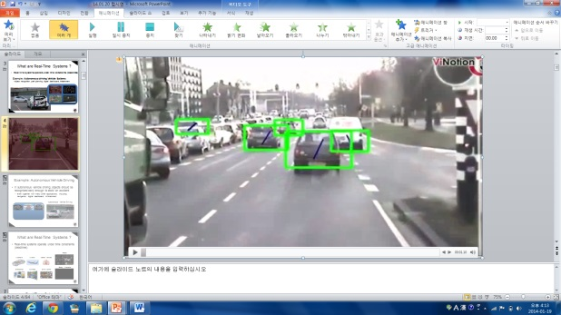
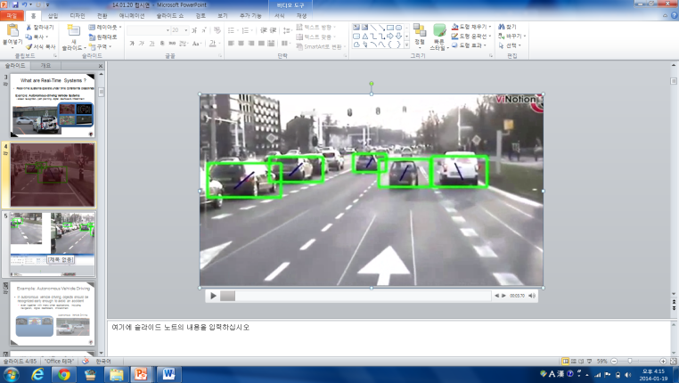
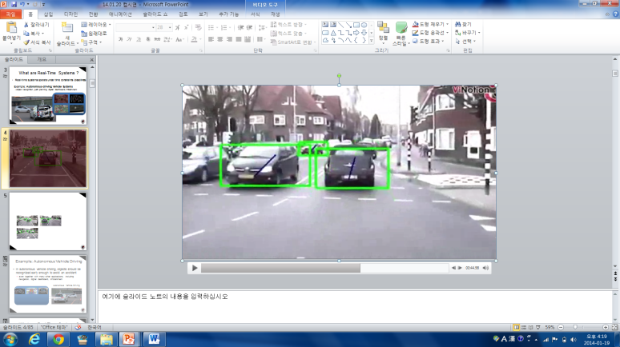
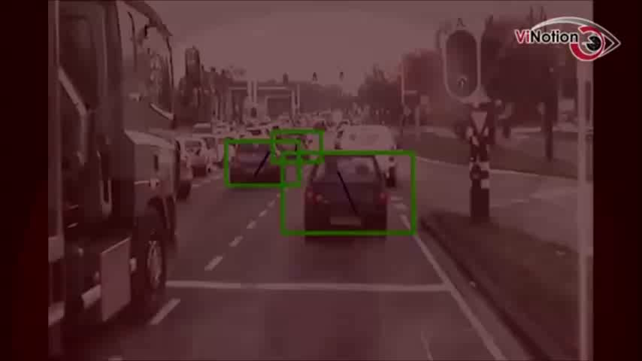
Real-time scheduling
Job : an individual computation (e.g., object recognition)
Task : a series of jobs (i.e., application)
Example (T=5, C=1, D=4)
Periodic task (T,C,D)
Period T = inter-release time (0 < T)
Deadline D
Worst-case execution time C (0 < C <= D <= T)
0
5
10
15

Slide 9
Scheduling algorithm & Schedulability analysis
higher priority on RM
T,C,D
Task₁
(3,1,3)
0
3
6
Task₂
(7,3,7)
5
release time
response time
deadline
preemption
Response time analysis
Rate Monotonic
scheduling algorithm
actual
WCET
1.safe WCET
estimation
possible execution times
2.worst case
interference
estimation
0
safe WCET
estimation
time
deadline
0
3.worst-case response time estimation
time

Slide 10
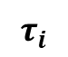
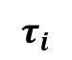
TFP vs. JFP
Priority-based Real-time Scheduling
Task-level fixed-priority (TFP)
A fixed priority to all the jobs of each single task
RM (rate-monotonic), DM (deadline-monotonic)
Job-level fixed-priority (JFP)
A fixed priority to each single job
EDF (earliest deadline first)
$$τ_{i}$$
< Expressiveness >
JFP
TFP
$$τ_{i}$$

Slide 11
Real-Time Scheduling
CPU
Real-time scheduling algorithms
Preemptive priority-based schedulers
▪ optimal TFP scheduling
RM (rate-monotonic)
▪ optimal JFP scheduling
- EDF (earlist-deadline-first)
Scheduler
Task
Task

Slide 12
RM (Rate Monotonic)
Optimal static-priority scheduling
It assigns priority according to period
A task with a shorter period has a higher priority
Executes a job with the shortest period
T₁
(4,1)
T₂
(5,2)
5
10
15
T₃
(7,2)
5
10
15

Slide 13
RM (Rate Monotonic)
Executes a job with the shortest period
T₁
(4,1)
T₂
(5,2)
5
10
15
T₃
(7,2)
5
10
15

Slide 14
RM (Rate Monotonic)
Executes a job with the shortest period
Deadline Miss !
T₁
(4,1)
T₂
(5,2)
5
10
15
T₃
(7,2)
5
10
15

Slide 15
EDF (Earliest Deadline First)
Optimal dynamic priority scheduling
A task with a shorter deadline has a higher priority
Executes a job with the earliest deadline
T₁
(4,1)
T₂
(5,2)
5
10
15
T₃
(7,2)
5
10
15

Slide 16
EDF (Earliest Deadline First)
Executes a job with the earliest deadline
T₁
(4,1)
T₂
(5,2)
5
10
15
T₃
(7,2)
5
10
15

Slide 17
EDF (Earliest Deadline First)
Executes a job with the earliest deadline
T₁
(4,1)
T₂
(5,2)
5
10
15
T₃
(7,2)
5
10
15

Slide 18
EDF (Earliest Deadline First)
Executes a job with the earliest deadline
T₁
(4,1)
T₂
(5,2)
5
10
15
T₃
(7,2)
5
10
15

Slide 19
EDF (Earliest Deadline First)
Optimal scheduling algorithm
if there is a schedule for a set of real-time tasks,
EDF can schedule it.
T₁
(4,1)
T₂
(5,2)
5
10
15
T₃
(7,2)
5
10
15

Slide 20
CPUScheduler Simulator V1 - Source Code Description
Overall description
Refer to documentation file.docx
Current code status (V1)
Uniprocessor is available
actually multiprocessors can be exploited by modifying corresponding variable in GlobalData.java
Rate monotonic is implemented
in Algorithm_RM.java
(At least 1000, up to 100,000) Task sets are randomly generated with bimodal and exponential distributions
The number of task sets that can be generated is dependent on the number of considered distribution and seed numbers
Any schedulability analysis is not implemented yet
Graph generation code is not included yet
I/O will not be considered

Slide 21
Source code sketch
output file read
GlobalData.java
ref
_gen_set.java
input file
read
_exec_set.java
__ResultCompare.java
T, C, D
create
Output sets of two (likewise, one) algorithms (analyses as well) are (likewise, is) compared
input file
generation
output file generation
PlatformInfo
(including Vector<Task>)
call
return result
Simulator.run(platformInfo)
call
create in every T of each task
LCM.generateLCM(periods)
Job
LCM is limited to 100,001
call in every time t (0<=t<=LCM)
Algorithm_RM.schedule()

Slide 22
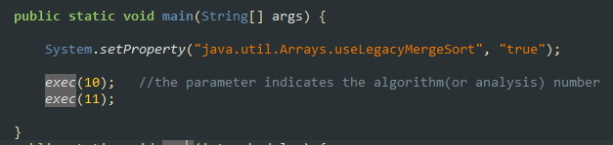
Practice 1 HW
You should Implement EDF scheduler in CPUScheduler V1
Follow the following steps
Algorithm number should be 11; modify _Exec_set.java as follows

Slide 23
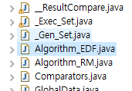
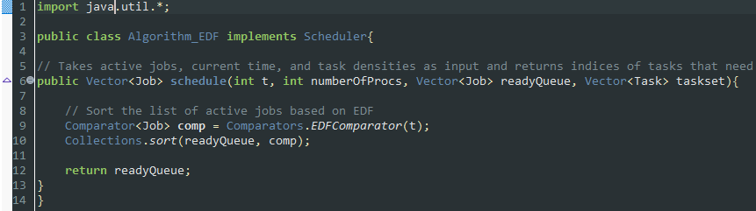
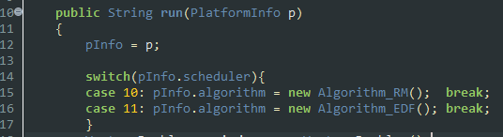
Practice 1 HW
Create Algorithm_EDF.java, and it should contain codes as follows
Simulator.java should additionally contain case 11: as follows

Slide 24
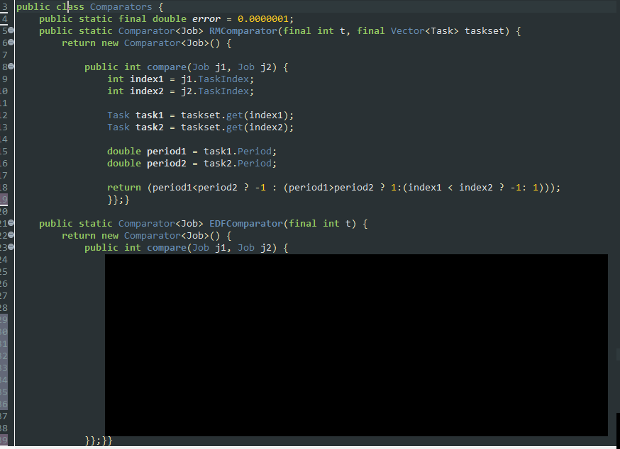
Practice 1 HW
Then, your own code is inserted at Comparators.java as follows
Your own code here

Slide 25
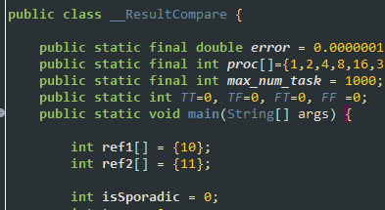
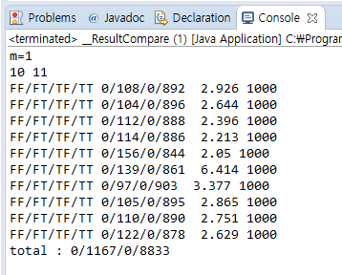
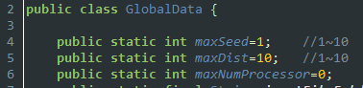
Practice 1 HW
_ResultCompare.java should be modified as follows; ref1[] = {10}, ref2[] = {11}
After correctly modifying Comparators.java, you see the following result by executing __ResultCompare.java
With GlobalData.java setting as
Note that output figures can be slightly different with the captured one

Slide 26
Practice 1 HW
Submission files
Comparators.java (yours)
Captured output (in console window) figure; one that you saw in Step 6
Description file (word or HWP)
Firm deadline : 공지사항 참조
About two weeks are provided
Instead, no delay is allowed
Delayed submission is graded as 0
Wrong output(source code as well) is graded as 0
Duplicated (from other peers) source code is graded as 'F‘
You should explain how to implement your source code in our class

